Slide 1
Gesprekstechnieken in VR
Maarten Struijk Wilbrink m.r.struijk@fsw.leidenuniv.nl
Isabella Saccardi i.saccardi@fsw.leidenuniv.nl
Notes:
haaaa
hooooooo

Slide 2
Overview
What is VR (for)?
Oculus Quest
The app
Tutorial + session in VR
Notes:
Session 1: VR, Design, Unity, Oculus Quest
Session 2: Editing
Session 3: Evaluation
Session 4: Presentation
At the end of the workgroup: submit a report

Slide 3
What is Virtual Reality?
“A computer-generated digital environment that can be experienced and interacted with as if that environment were real”
(Jerald, 2015)

Slide 4
Virtual Reality (in practice)
Any application designed to work with a device that tracks your head movement:
Perspective change!

Slide 5
VR provides understanding.
By using many human motor skills and sensory capabilities,
you increase understanding and learning
(Dale 1969 adapted from Jerald 2016)
Notes:
Such as understanding an entertaining story, learning an abstract concept, or practicing a real skill.
Actively using more of the human sensory capability and motor skills has been known to increase understanding/learning for some time (Dale, 1969).
Jason Jerald (2016) Chapter 1.3 : What is VR good for?
This is in part due to the increased sensory bandwidth between human and information, but there is much more to understanding. Actively participating in an action, making concepts intuitive, encouraging motivation through engaging experiences, and the thoughts inside one’s head all contribute to understanding.
(Jerald, 2015)

Slide 6
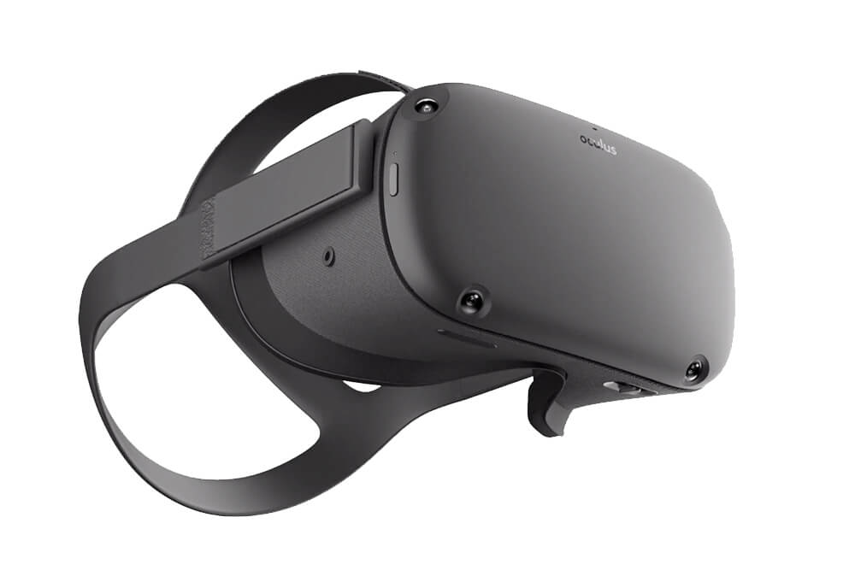
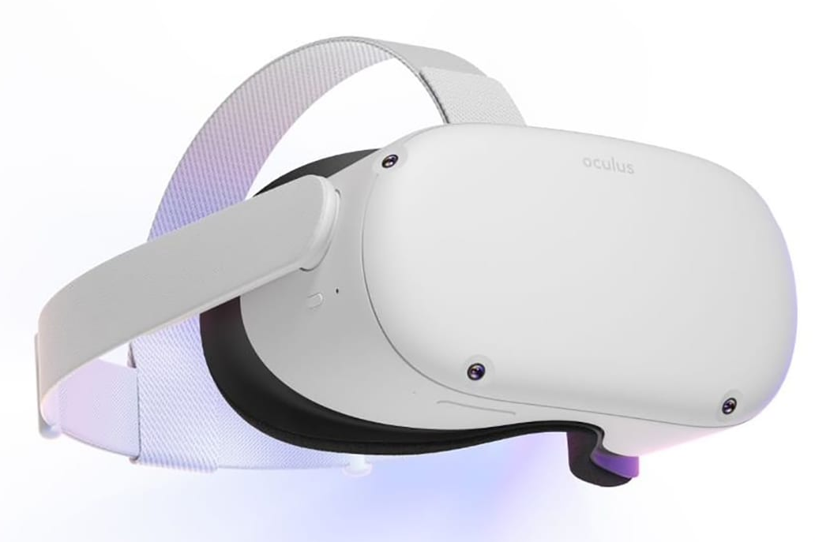
Oculus Quest
HMD
Masks and wipes
IPD
Turning on and off
Securing the headset
Straps
Knob
Headphones + volume
Power
Volume
Notes:
Guardian: https://youtu.be/zh5ldprM5Mg

Slide 7
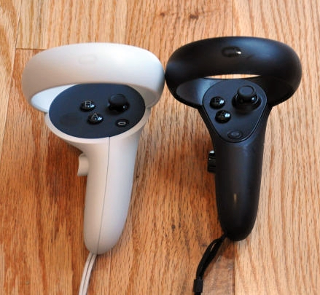
Oculus Quest
Controllers
Wear the straps! (for emergency exit)
Buttons
Grabbing → Grip on side (middle finger)
Select using laser → Trigger (index finger)
Recentering → Long press Oculus Button (right thumb)
Exit app → Short press Oculus Button (right thumb)
Notes:
Guardian: https://youtu.be/zh5ldprM5Mg

Slide 8
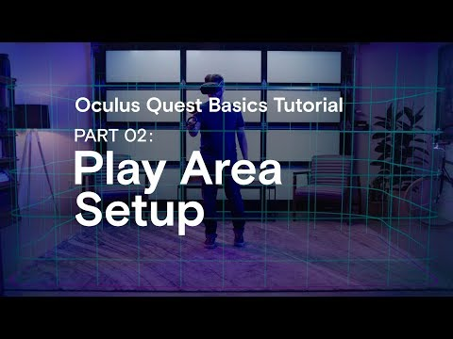
Oculus Quest - Guardian Setup
Notes:
Guardian: https://youtu.be/zh5ldprM5Mg

Slide 9
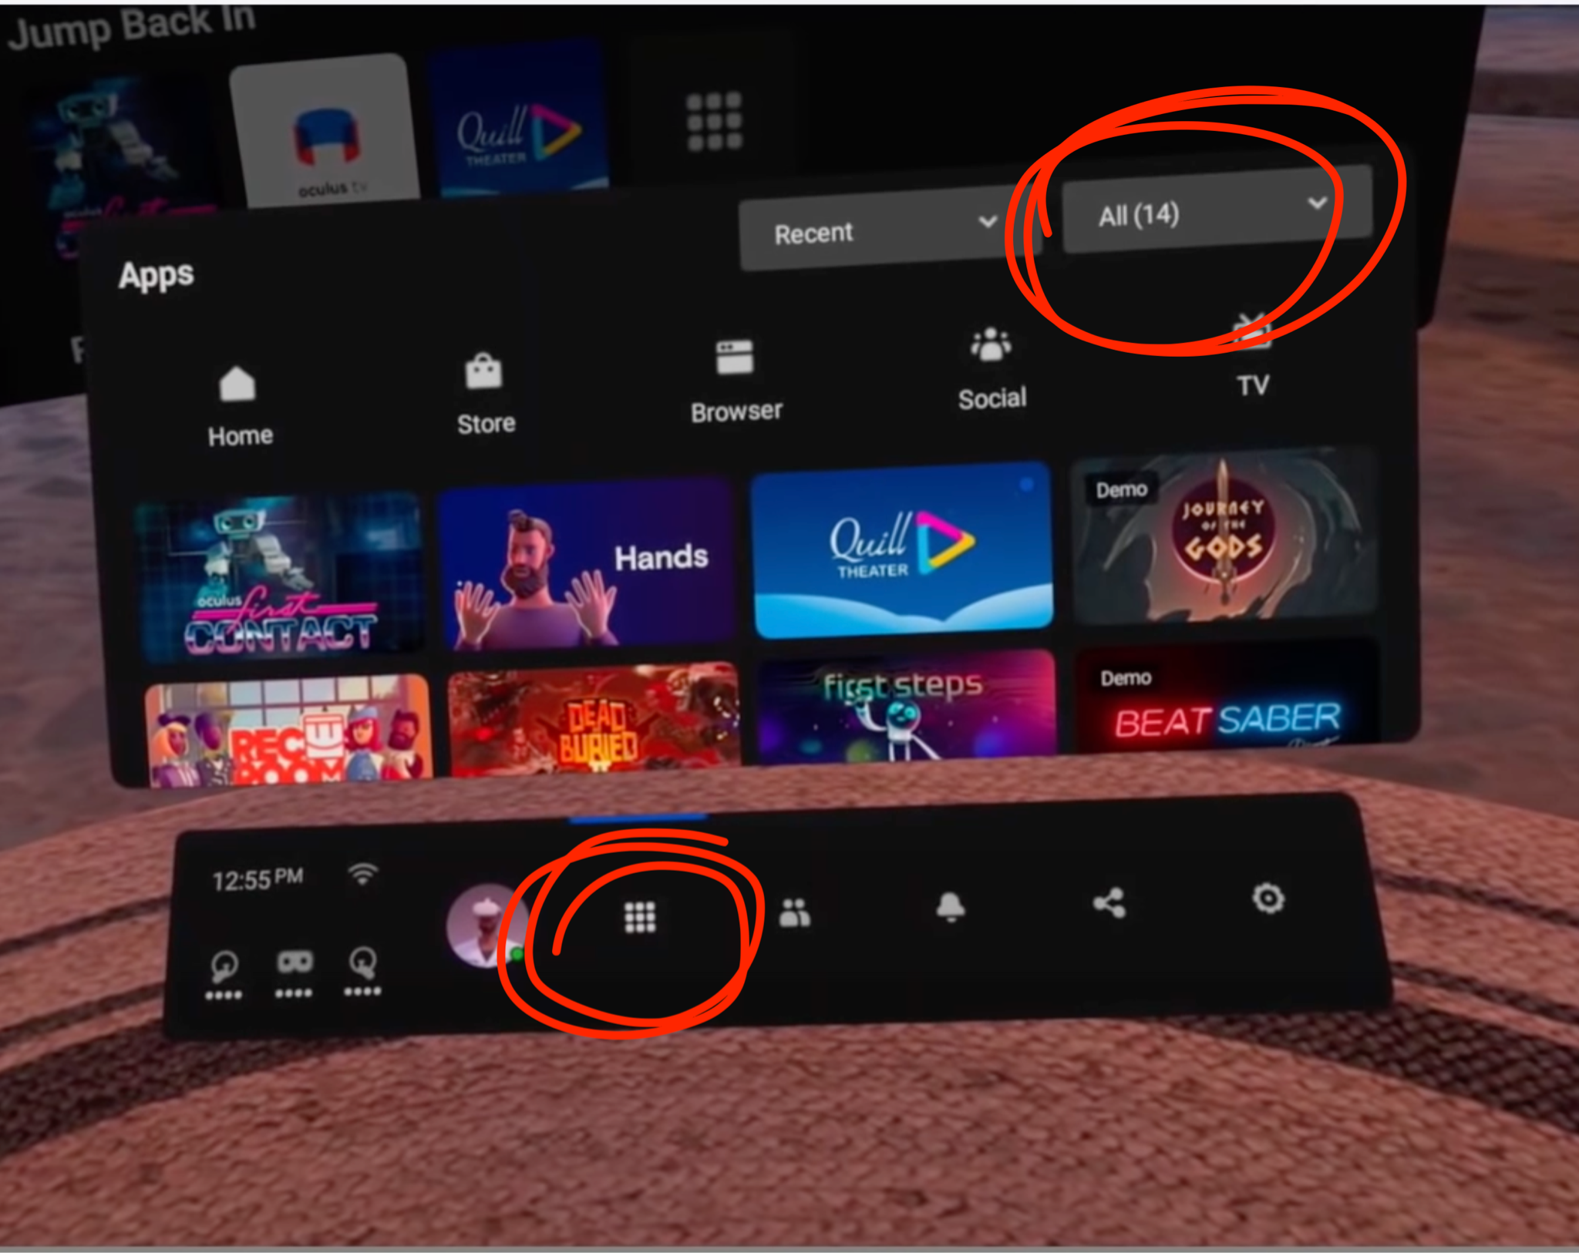
Where to find the Program
← 2. Click on ‘All’ to scroll down to
‘Unknown Sources’
3. Select ‘GPInteraction’
← 1. First click here

Slide 10
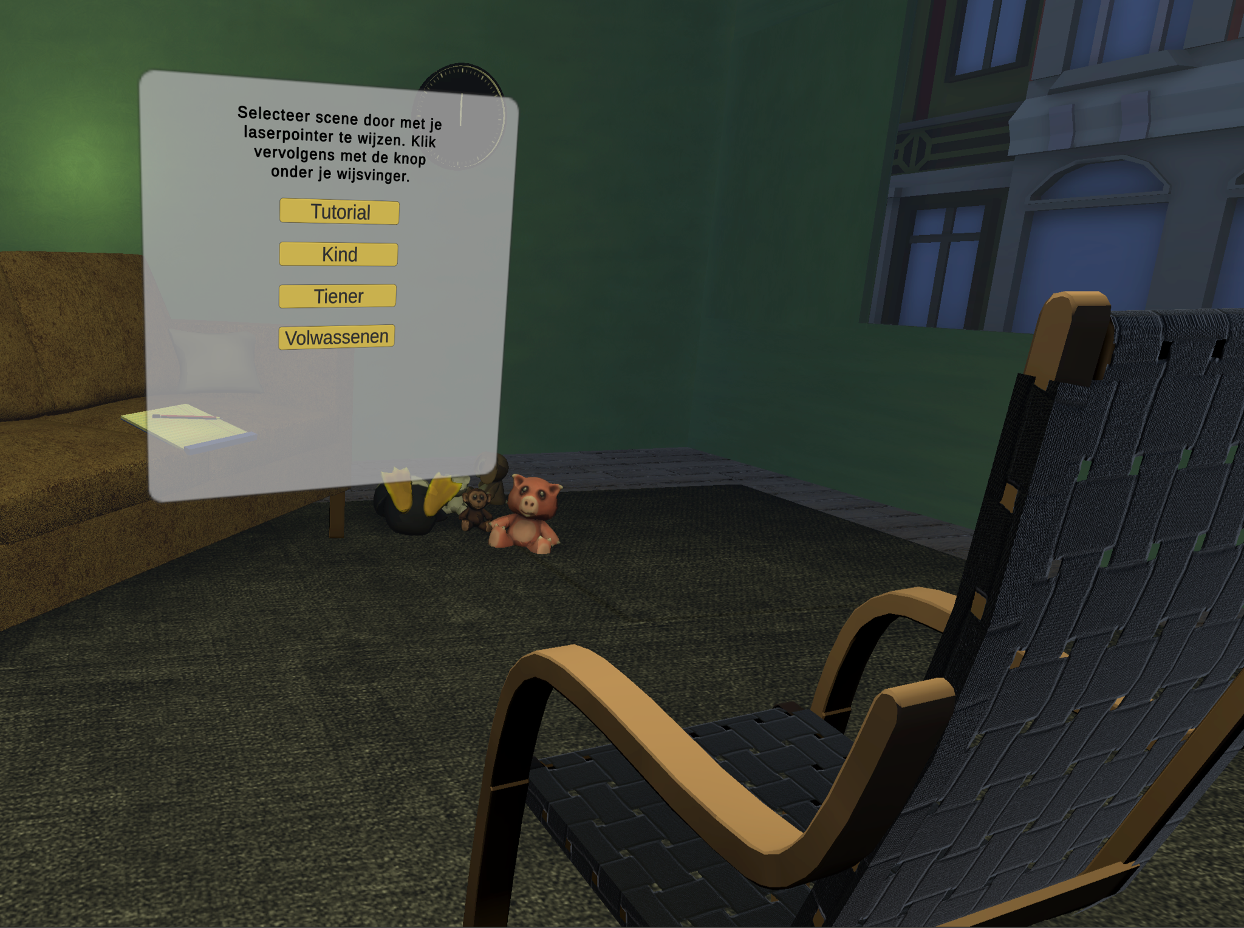
About the menu

Slide 11
Today we‘re going to do:
Tutorial
Ouders

Slide 12
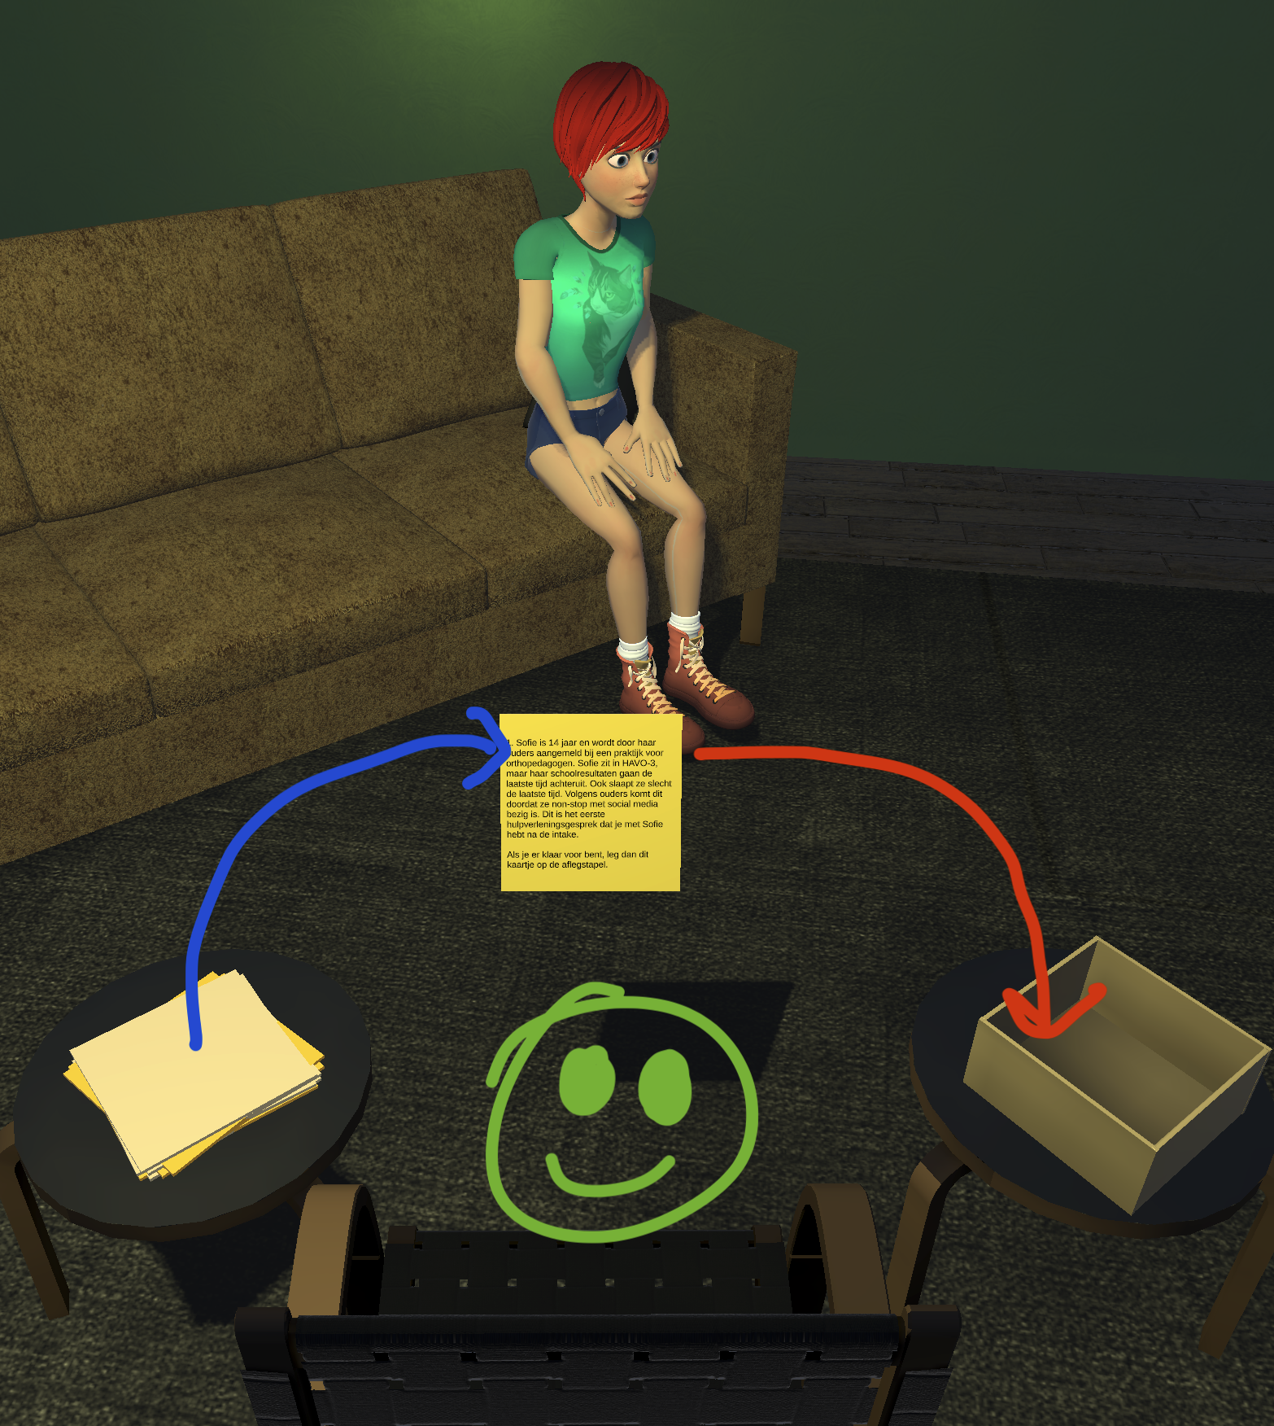
Interaction flow
Situatieschets (sometimes out loud)
Response by client
Your own response (out loud)
Pick one of three pre-set responses
Response by client
Feedback by coach
Restart or continue to next interaction

Slide 13
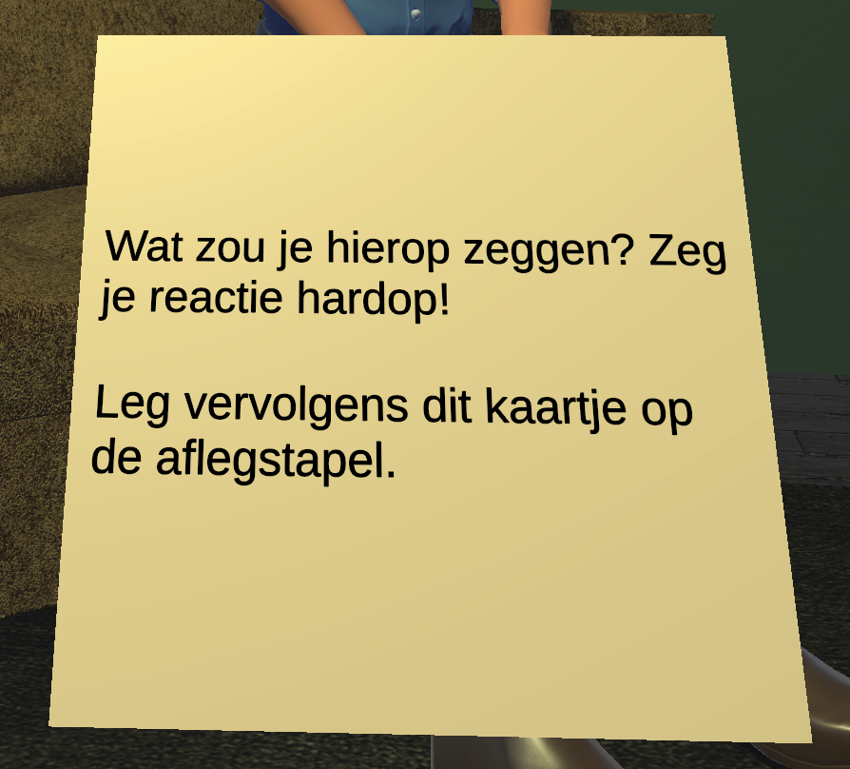
Interaction flow
Situatieschets (sometimes out loud)
Response by client
Your own response (out loud)
Pick one of three pre-set responses
Response by client
Feedback by coach
Restart or continue to next interaction

Slide 14
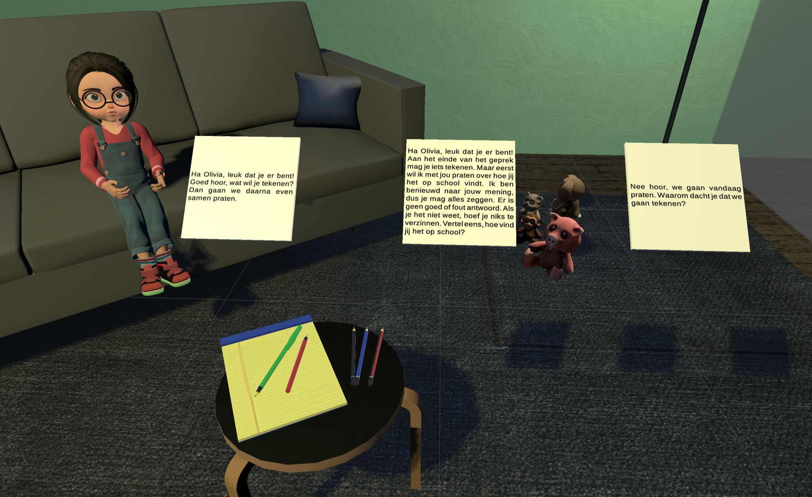
Interaction flow
Situatieschets (sometimes out loud)
Response by client
Your own response (out loud)
Pick one of three pre-set responses
Response by client
Feedback by coach
Restart or continue to next interaction

Slide 15
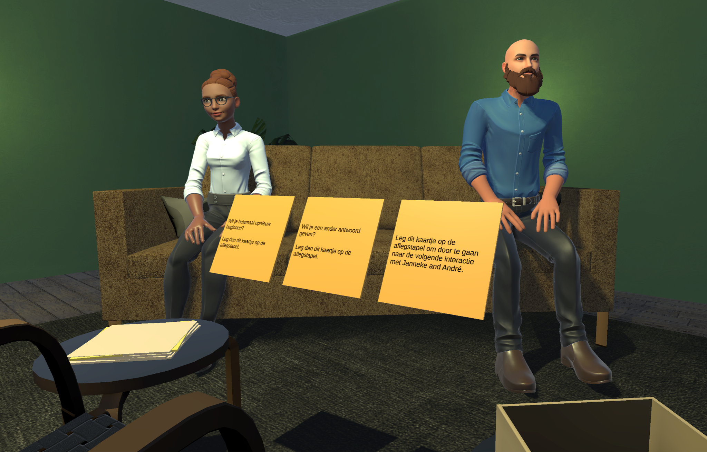
Interaction flow
Situatieschets (sometimes out loud)
Response by client
Your own response (out loud)
Pick one of three pre-set responses (again, out loud)
Response by client
Feedback by coach
Restart or continue to next interaction

Slide 16

One more thing
Stay seated
Nauseated?
Close your eyes.
Drop both controllers (straps!)
Take off headset
Record your voice using phone or laptop
Participating in our research?
If you subscribed but haven’t answered to the questionnaire, do it BEFORE the workshop

Slide 17
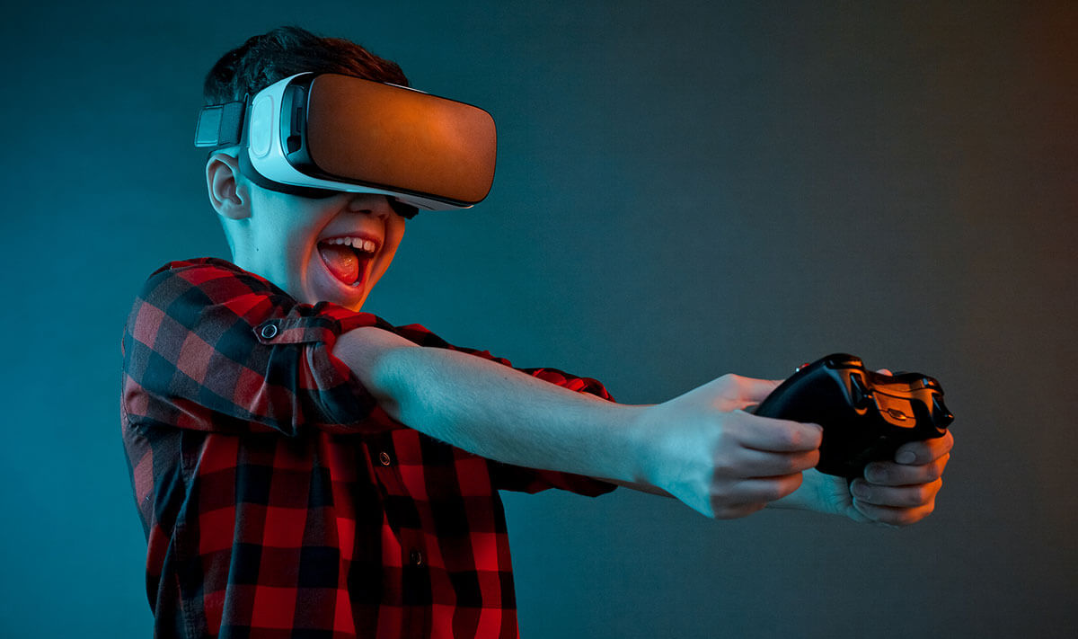
One more thing
DON’T MESS WITH EACH OTHER!
This needs to be a safe environment

Slide 18
What are your questions?

Slide 19
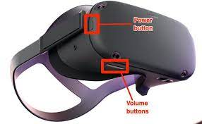
Now it’s your turn!
Apply the mask
Wear & secure the headset
Turn the headset on
Select the program
Click the square icon on the bottom bar
Click on all for scrolling down to “unknown sources”
Click on “GP interaction”

Slide 20
Further reading & Useful links
Jerald, J. (2018). Human-Centered VR Design: Five Essentials Every Engineer Needs to Know.
Bailenson, J. (2018). Experience on demand: What virtual reality is, how it works, and what it can do. (Chapter 10)
Pan, X., & Hamilton, A. F. D. C. (2018). Why and how to use virtual reality to study human social interaction: The challenges of exploring a new research landscape
MindTech Symposium 2018 - Daniel Freeman - Automated Virtual Reality Psychological Therapy
(Dutch) Virtual Reality creëert echte herinneringen
Unity Learn
Videos:
Your Brain on VR
Carne y Arena

